Slide 1






PDS
Computer Vision
Manipulating site-local BGP routing
@ P. Siagian
https://github.com/siagianp
https://www.youtube.com/@AmelOline/videos
https://github.com/amelcharolinesgn2/IoT_simulator-mqtt-NodeRed
https://github.com/amelcharolinesgn2/Cloud-Infrastructures
https://github.com/amelcharolinesgn2/ClouD-Infrastructure-SISKA-2025
https://github.com/amelcharolinesgn2/Gyroscope-Sensor-Data-Accelerometer
Notes:
https://github.com/Rakibul73/Cisco_Network_Routing_Switching
https://github.com/Rakibul73/Cisco_Network_Routing_Switching/tree/main/Problem_Lab_BGP
https://networklessons.com/labs/bgp-professional-lab-1#BGP_Prefer_eBGP_over_iBGP
https://github.com/Rakibul73/whiteboard-app

Slide 2
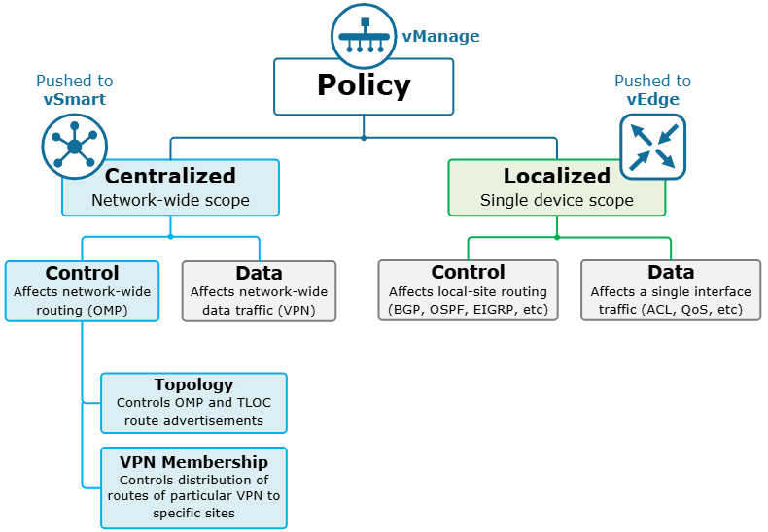
What is a Centralized Control Policy?
In Cisco SD-WAN, there are two types of Centralized Control Policies:
Topology - Topology policies control the route information such as omp, tloc, and service routes that are being redistributed to a list of sites. As the name implies, they are typically used for limiting the number of overlay tunnels between sites and controlling the overlay topology.
VPN Membership - VPN Membership policies are used to control the distribution of routing information for specific VPNs to a list of sites. A typical use-case is for creating guest networks that have Internet access but site-to-site communication is restricted.
Figure 1. Types of Cisco SD-WAN Policies
Notes:
https://www.networkacademy.io/ccie-enterprise/sdwan/what-is-a-centralized-control-policy

Slide 3
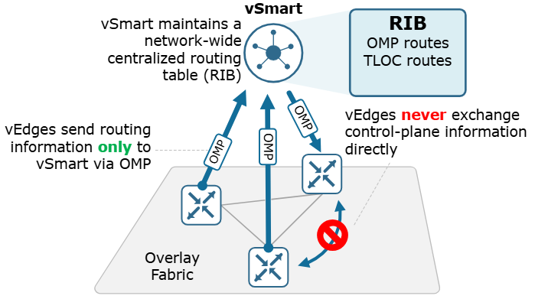
vEdge-1 sends an OMP Update to the controllers, vSmart processes this message and if needed sends out an update to all other WAN edge devices
Route Types
There are three types of OMP routes that the vSmart controllers learn from the WAN edge devices:
OMP routes - These routes represent prefix information that WAN edge devices learn from their local network. For example, these could be connected networks, static routes, or an OSPF process running onsite redistributed into OMP. The OMP routes could be displayed using the show omp command.
TLOC routes - These routes simply carry TLOC information from vEdges to the vSmart controllers. They could be displayed using the show omp tlocs command.
Service routes - These routes represent network services, such as firewalls and IPS, that are running on the local-site network to which
the vEdge router is connected. They could be displayed using the show omp services command.
Figure 2. Cisco SD-WAN Exchange of Control Plane information

Slide 4
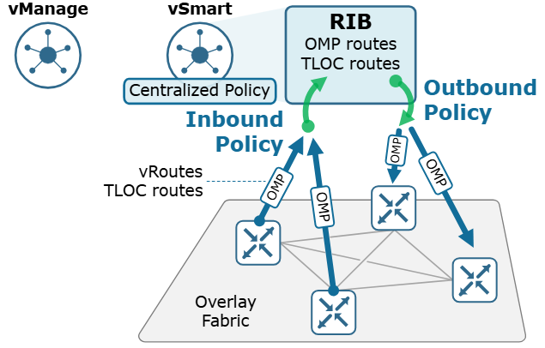
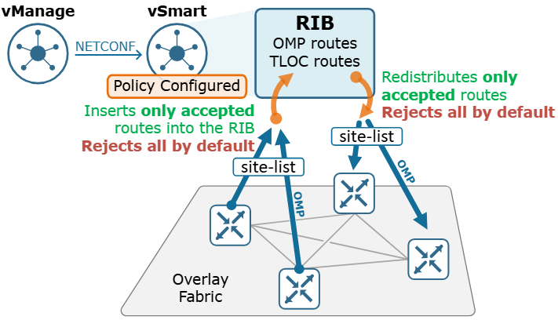
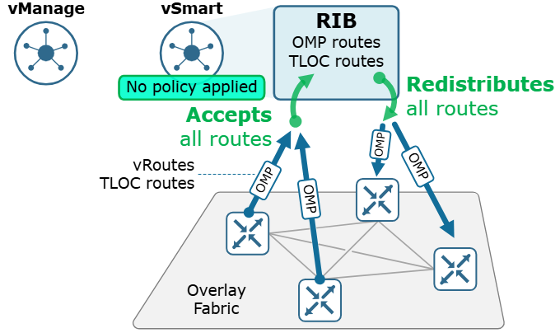
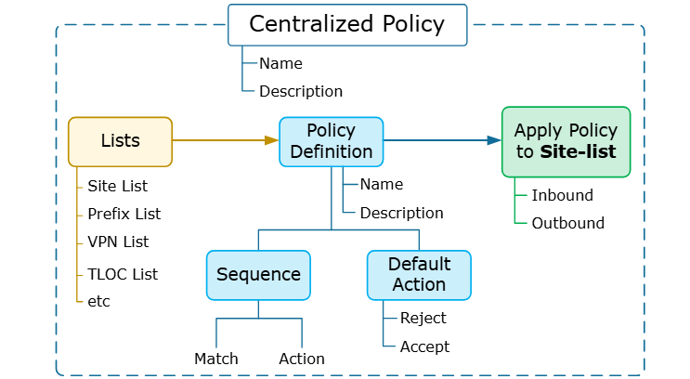
Centralized Control Policy
vSmart Behaviour with Centralized Policy
Policy Components:
Create Groups of Interest
Configure Topology and VPN Membership
Apply Policies to Sites and VPNs

Slide 5
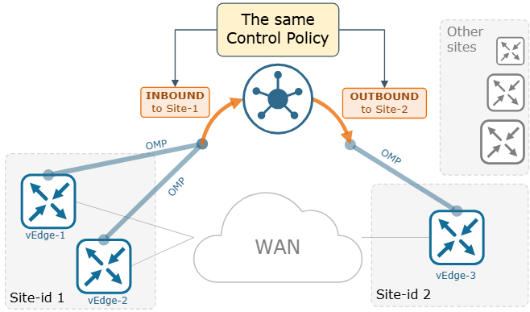
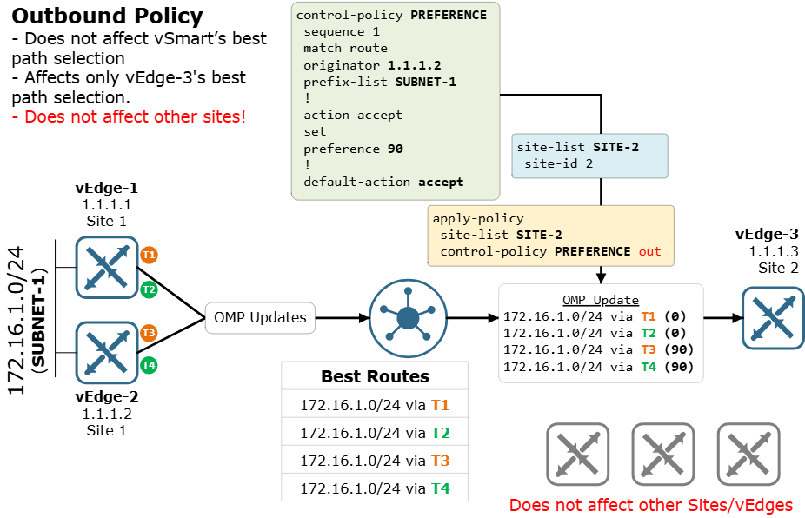
Inbound vs Outbound Control Policy
Cisco WAN Edge routers
Outbound Policy
Figure 2 shows a control policy named PREFERENCE that is applied to Site-list SITE-2 in an outbound direction. Let's break down the policy construct into bullet points and analyze every aspect of it.
The direction of the policy is always from the perspective of the vSmart controller. Outbound means that the policy matches and modifies attributes in the OMP advertisements from vSmart to vEdges.
The policy is applied to site-list SITE-2 means that only OMP advertisements send to WAN edge devices with Site-IDs listed in the SITE-2 list are processed against the policy.
In the policy itself, sequence 1 match route means that this sequence matches and modifies only vRoutes (and not TLOCs or Service routes).
The action accept means that the vRoutes that are matched in the statement will be sent out to site-2.
Set preference 90 means that the OMP Preference attribute of the vRoutes that are matched will be changed to 90 (default is 0).
Note that the default action is accept (it is reject by default). We do not intend to filter out any route or tlocs but to only modify route attributes.
Figure 1. The same control policy in different directions
Notes:
Lab #2 Two LANs connected by a router
http://wpage.unina.it/rcanonic/didattica/gns3-labs/lab2/
Lab #16 MPLS with static Label Switched Path (LSP)
http://wpage.unina.it/rcanonic/didattica/gns3-labs/lab16/
https://www.quisted.net/index.php/2018/04/30/lab-viii-mpls-mp-bgp-eompls/
https://blog.pierky.com/gns3-lab-bgp-multihoming-to-a-single-provider-with-partial-routing/

Slide 6
check the OMP routing table of vSmart:
check the routing information on vEdge-3.
vEdge-3# show omp routes 172.16.1.0/24 | tab
Code:
C -> chosen
I -> installed
Red -> redistributed
Rej -> rejected
L -> looped
R -> resolved
S -> stale
Ext -> extranetvEdge-3# show omp routes 172.16.1.0/24 | tab
Code:
C -> chosen
I -> installed
Red -> redistributed
Rej -> rejected
L -> looped
R -> resolved
S -> stale
Ext -> extranet
Inv -> invalid
Stg -> staged
IA -> On-demand inactive
U -> TLOC unresolved
PATH ATTRIBUTE
VPN PREFIX FROM PEER ID LABEL STATUS TYPE TLOC IP COLOR ENCAP PREFERENCE
--------------------------------------------------------------------------------------------------------------------------------------
1 172.16.1.0/24 1.1.1.30 11 1004 C,I,R installed 1.1.1.2 mpls ipsec 90
1.1.1.30 12 1004 C,I,R installed 1.1.1.2 public-internet ipsec 90
1.1.1.30 13 1004 R installed 1.1.1.1 mpls ipsec -
1.1.1.30 14 1004 R installed 1.1.1.1 public-internet ipsec -
Inv -> invalid
Stg -> staged
IA -> On-demand inactive
U -> TLOC unresolved
PATH ATTRIBUTE
VPN PREFIX FROM PEER ID LABEL STATUS TYPE TLOC IP COLOR ENCAP PREFERENCE
--------------------------------------------------------------------------------------------------------------------------------------
1 172.16.1.0/24 1.1.1.30 11 1004 C,I,R installed 1.1.1.2 mpls ipsec 90
1.1.1.30 12 1004 C,I,R installed 1.1.1.2 public-internet ipsec 90
1.1.1.30 13 1004 R installed 1.1.1.1 mpls ipsec -
1.1.1.30 14 1004 R installed 1.1.1.1 public-internet ipsec -
vSmart# show omp routes 172.16.1.0/24 | tab
Code:
C -> chosen
I -> installed
Red -> redistributed
Rej -> rejected
L -> looped
R -> resolved
S -> stale
Ext -> extranet
Inv -> invalid
Stg -> staged
IA -> On-demand inactive
U -> TLOC unresolved
PATH ATTRIBUTE
VPN PREFIX FROM PEER ID LABEL STATUS TYPE TLOC IP COLOR ENCAP PREFERENCE
--------------------------------------------------------------------------------------------------------------------------------------
1 172.16.1.0/24 1.1.1.1 66 1004 C,R installed 1.1.1.1 mpls ipsec -
1.1.1.1 69 1004 C,R installed 1.1.1.1 public-internet ipsec -
1.1.1.2 66 1004 C,R installed 1.1.1.2 mpls ipsec -
1.1.1.2 69 1004 C,R installed 1.1.1.2 public-internet ipsec -

Slide 7
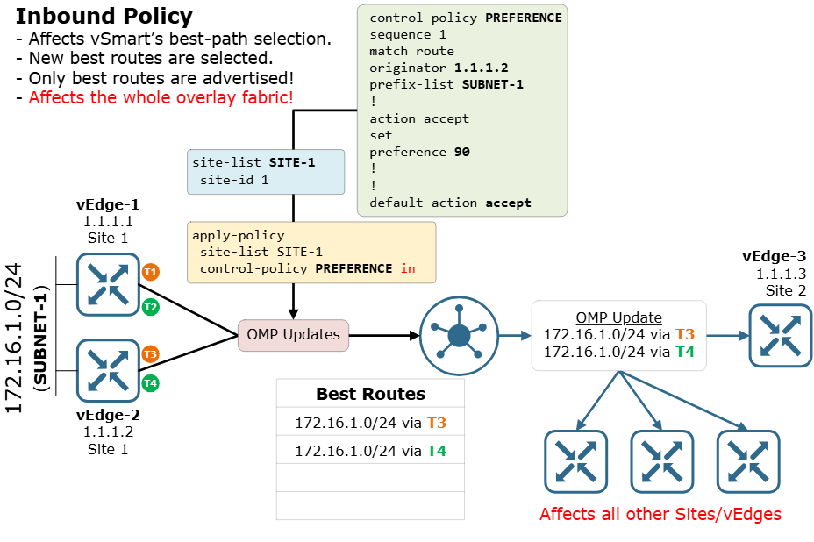
check the omp routing table of any other WAN edge router, we will see that they have chosen and installed all four equal-cost routes for 172.16.1.0/24.
vEdge-4# show omp routes 172.16.1.0/24 | tab
PATH ATTRIBUTE
VPN PREFIX FROM PEER ID LABEL STATUS TYPE TLOC IP COLOR ENCAP PREFERENCE
--------------------------------------------------------------------------------------------------------------------------------------
1 172.16.1.0/24 1.1.1.30 5 1004 C,I,R installed 1.1.1.2 mpls ipsec -
1.1.1.30 6 1004 C,I,R installed 1.1.1.2 public-internet ipsec -
1.1.1.30 7 1004 C,I,R installed 1.1.1.1 mpls ipsec -
1.1.1.30 8 1004 C,I,R installed 1.1.1.1 public-internet ipsec -
Notes:
http://wpage.unina.it/rcanonic/didattica/gns3-labs/lab2/
https://www.networkacademy.io/ccie-enterprise/sdwan/localized-policies

Slide 8
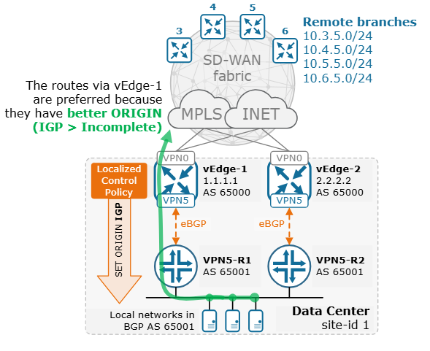
Manipulating site-local BGP routing
CORE-SW1#sh ip route bgp
Gateway of last resort is not set
10.0.0.0/8 is variably subnetted, 6 subnets, 2 masks
B 10.3.5.0/24 [20/1000] via 172.16.1.2, 00:02:07
[20/1000] via 172.16.1.1, 00:02:07
B 10.4.5.0/24 [20/1000] via 172.16.1.2, 00:02:07
[20/1000] via 172.16.1.1, 00:02:07
B 10.5.5.0/24 [20/1000] via 172.16.1.2, 00:02:07
[20/1000] via 172.16.1.1, 00:02:07
B 10.6.5.0/24 [20/1000] via 172.16.1.2, 00:02:07
[20/1000] via 172.16.1.1, 00:02:07
policy
route-policy SET-ORIGIN-IGP
sequence 11
action accept
set
origin igp
!
default-action accept
!
Configuring a route policy
vEdge-1# conf t
Entering configuration mode terminal
vEdge-1(config)# policy
vEdge-1(config-policy)# route-policy SET-ORIGIN-IGP
vEdge-1(config-route-policy-SET-ORIGIN-IGP)# sequence 11
vEdge-1(config-sequence-11)# action accept
vEdge-1(config-action)#set origin igp
vEdge-1(config-set)# default-action accept
vEdge-1(config-route-policy-SET-ORIGIN-IGP)# commit and-quit
Notes:
https://www.slideserve.com/hatten/lecture-7-l2-mpls-vpn-vpws-h-vpls-powerpoint-ppt-presentation

Slide 9
CORE-SW1#sh ip route bgp
Gateway of last resort is not set
10.0.0.0/8 is variably subnetted, 6 subnets, 2 masks
B 10.3.5.0/24 [20/1000] via 172.16.1.1, 00:00:55
B 10.4.5.0/24 [20/1000] via 172.16.1.1, 00:00:55
B 10.5.5.0/24 [20/1000] via 172.16.1.1, 00:00:55
B 10.6.5.0/24 [20/1000] via 172.16.1.1, 00:00:55
vpn 5
router
bgp 65000
propagate-aspath
address-family ipv4-unicast
redistribute omp
!
neighbor 172.16.1.1
no shutdown
remote-as 65001
address-family ipv4-unicast
route-policy SET-ORIGIN-IGP out
!
neighbor 172.16.1.2
no shutdown
remote-as 65001
address-family ipv4-unicast
route-policy SET-ORIGIN-IGP out
!
CORE-SW1#sh ip bgp 10.3.5.0/24
BGP routing table entry for 10.3.5.0/24, version 3
Paths: (2 available, best #2, table default)
Multipath: eBGP
Advertised to update-groups:
2
Refresh Epoch 1
65000
172.16.1.2 from 172.16.1.2 (1.1.1.2)
Origin incomplete, metric 1000, localpref 100, valid, external
Extended Community: SoO:0:1
rx pathid: 0, tx pathid: 0
Refresh Epoch 1
65000
172.16.1.1 from 172.16.1.1 (1.1.1.1)
Origin IGP, metric 1000, localpref 100, valid, external, best
Extended Community: SoO:0:1
rx pathid: 0, tx pathid: 0x0
http://wpage.unina.it/rcanonic/didattica/gns3-labs/lab16/
Notes:
http://wpage.unina.it/rcanonic/didattica/gns3-labs/lab16/

Slide 10
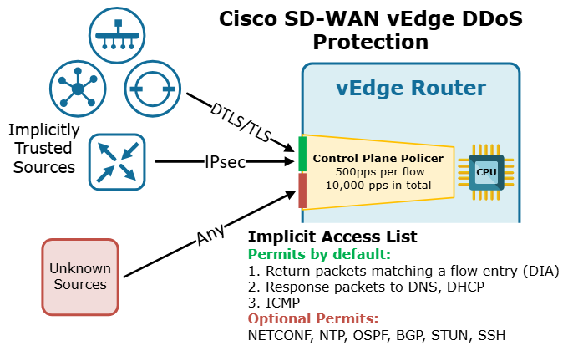
Implicit Access Control List (ACL)
vEdge-1(config-tunnel-interface)# allow-service ?
Possible completions:
all Allow all traffic.
bgp Allow/deny BGP
dhcp Allow/deny DHCP
dns Allow/deny DNS
https Allow/deny HTTPS
icmp Allow/deny ICMP
netconf Allow/deny NETCONF
ntp Allow/deny NTP
ospf Allow/deny OSPF
sshd Allow/deny SSH
stun Allow/deny STUN
Why are implicit ACLs important?
Notes:
Lab #2 Two LANs connected by a router
http://wpage.unina.it/rcanonic/didattica/gns3-labs/lab2/
Lab #16 MPLS with static Label Switched Path (LSP)
http://wpage.unina.it/rcanonic/didattica/gns3-labs/lab16/
https://www.quisted.net/index.php/2018/04/30/lab-viii-mpls-mp-bgp-eompls/
https://blog.pierky.com/gns3-lab-bgp-multihoming-to-a-single-provider-with-partial-routing/

Slide 11
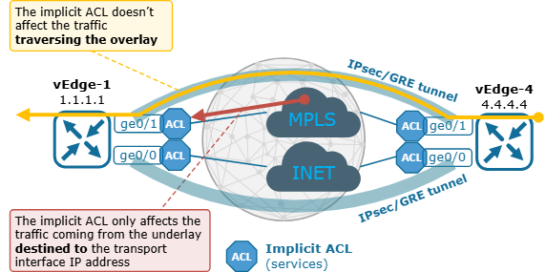
What are Implicit ACLs?
Allowing SSH to a vEdge router from the underlay
vEdge-1# show interface | t
IF IF IF
AF ADMIN OPER TRACKER
VPN INTERFACE TYPE IP ADDRESS STATUS STATUS STATUS PORT TYPE
-----------------------------------------------------------------------------
0 ge0/0 ipv4 39.3.0.1/24 Up Up NA transport
0 ge0/1 ipv4 10.10.0.1/24 Up Up NA transport
0 ge0/6 ipv4 10.0.0.12/24 Up Up NA service
0 system ipv4 1.1.1.1/32 Up Up NA loopback
Notes:
Lab #2 Two LANs connected by a router
http://wpage.unina.it/rcanonic/didattica/gns3-labs/lab2/
Lab #16 MPLS with static Label Switched Path (LSP)
http://wpage.unina.it/rcanonic/didattica/gns3-labs/lab16/
https://www.quisted.net/index.php/2018/04/30/lab-viii-mpls-mp-bgp-eompls/
https://blog.pierky.com/gns3-lab-bgp-multihoming-to-a-single-provider-with-partial-routing/

Slide 12
Gateway Protocol
Notes:
https://www.quisted.net/index.php/2018/04/30/lab-viii-mpls-mp-bgp-eompls/

Slide 13
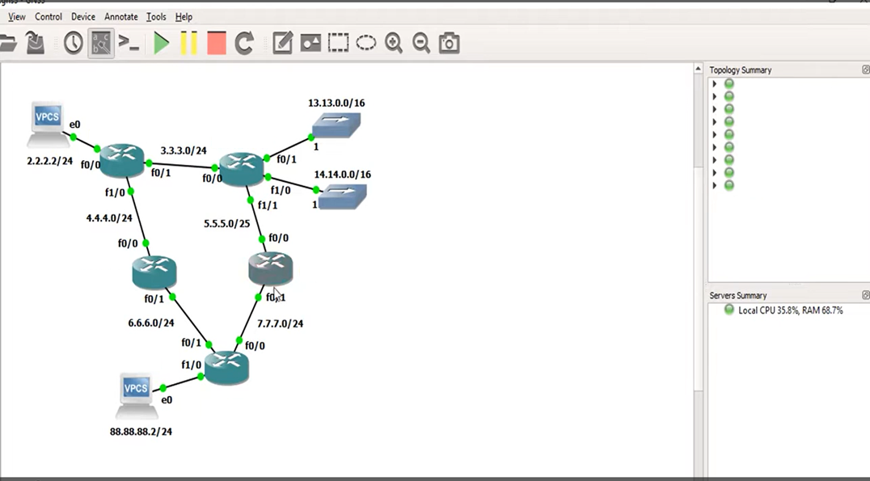
Cisco.net
SGB-600
BLG-700
AMA-AS200
13.13.0.0/16
14.14.0.0/16
Cisco.net
L3-AS_100
ISP-901
L3-AS_100
AMA-AS200
SBG-600
BLG-700
myVPCS.com
ISP-901

